Slide 1






The Netherlands eScience Center

Slide 2

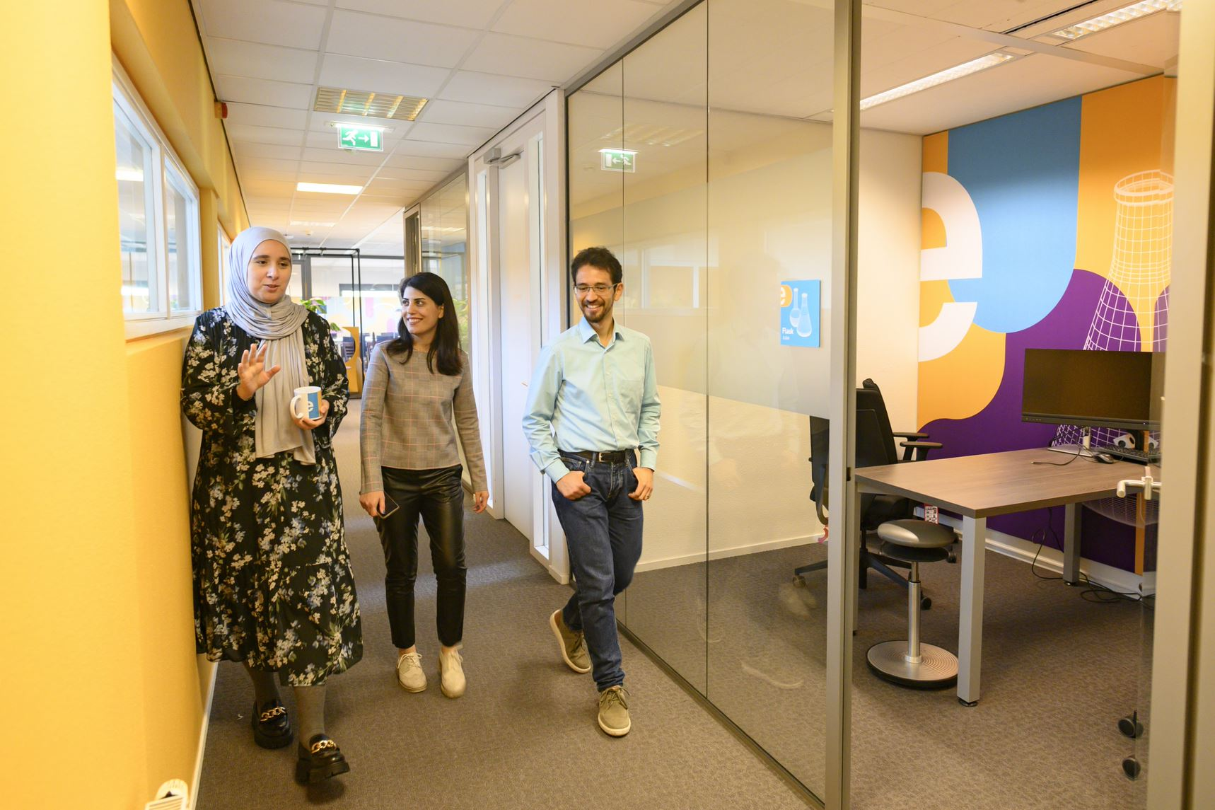

Who are we?
The Netherlands eScience Center is a national center for innovative software solutions in academic research.
Established to bridge the gap between digital technologies and scientific and scholarly inquiry.
Our Research Software Engineers
help researchers interpret results,
make tools and methods reusable for the wider research community,
co-author research and methodological publications.

Slide 3

Digital Skills Programme​​
Hands-on courses, 2-3 days
In person & online
Based on The Carpentries & CodeRefinery, and
In-house developed materials.
Topics cover:
Open & Reproducible Research Software
Intermediate and Advanced Research Software Skills
Advanced Technologies (e.g. GPUs, Deep Learning)
Schedule 2023
January | Data Analysis and Visualisation in Python for Researchers Machine learning in Python with scikit-learn | July | Parallel Programming with Python
March | Reproducible research with R packages Intermediate Research Software Development with Python Astronomical Data Science with Python | August | Introduction to Deep Learning
April | Parallel Programming with Python GPU programming | September | Reproducible research with R packages Good Practices in Research Software Development (CodeRefinery)
May | Introduction to Geospatial Raster and Vector Data with Python Introduction to Deep Learning | October | Introduction to Geospatial Raster and Vector Data with Python GPU programming
June | Image Processing with Python Good Practices in Research Software Development (CodeRefinery) | November | Foundations of astronomical data science

Slide 4
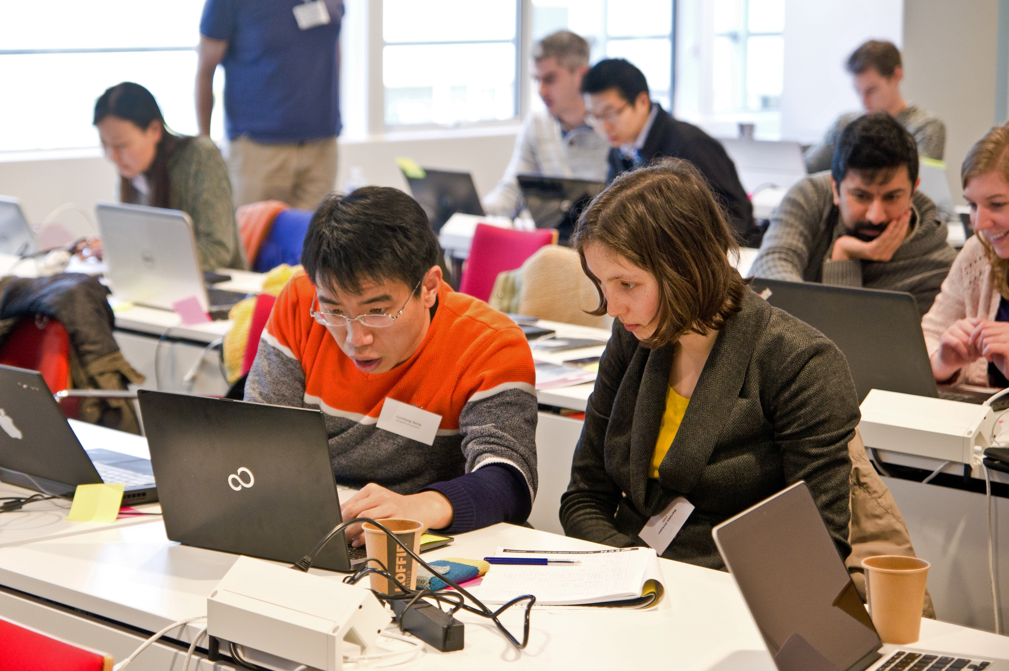


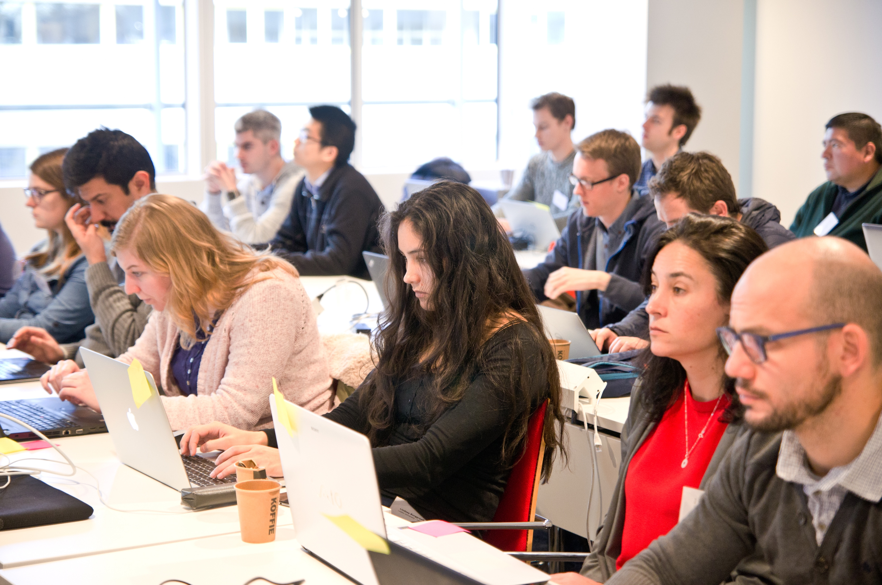

Our Digital Skills Workshops are free and open to researchers in the Netherlands. We also offer paid options of custom workshops dedicated to your organisation. To learn more, contact: training@esciencecenter.nl See upcoming workshops: esciencecenter.nl/events/?f=workshopsnl/events/?f=workshops To be notified about coming up workshops, subscribe to the Newsletter eepurl.com/dtjzwP
Digital Skills Programme​​

Slide 5

NL-RSE brings together the community of people writing and contributing to research software from Dutch universities, knowledge institutes, companies and other organizations to share knowledge, to organize meetings, and raise awareness for the scientific recognition of research software.
Website: https://nl-rse.org/
Email: info@nl-rse.org
Twitter: @nl_rse

Slide 6
Submit now!
Become part of the eScience Center community and meet with other Fellows: passionate advocates of research software (3 times a year)
Open to researchers and research software enthusiasts from all disciplines
Receive training, budget and consultancy from eScience Center employees on improving awareness and community efforts around research software
Timeline:
11 April: Deadline project proposal
Early May: Interviews
7 June: kick-off
Fellowship Programme 2023-2024
More info and apply at: esciencecenter.nl/fellowship-programme

Slide 7
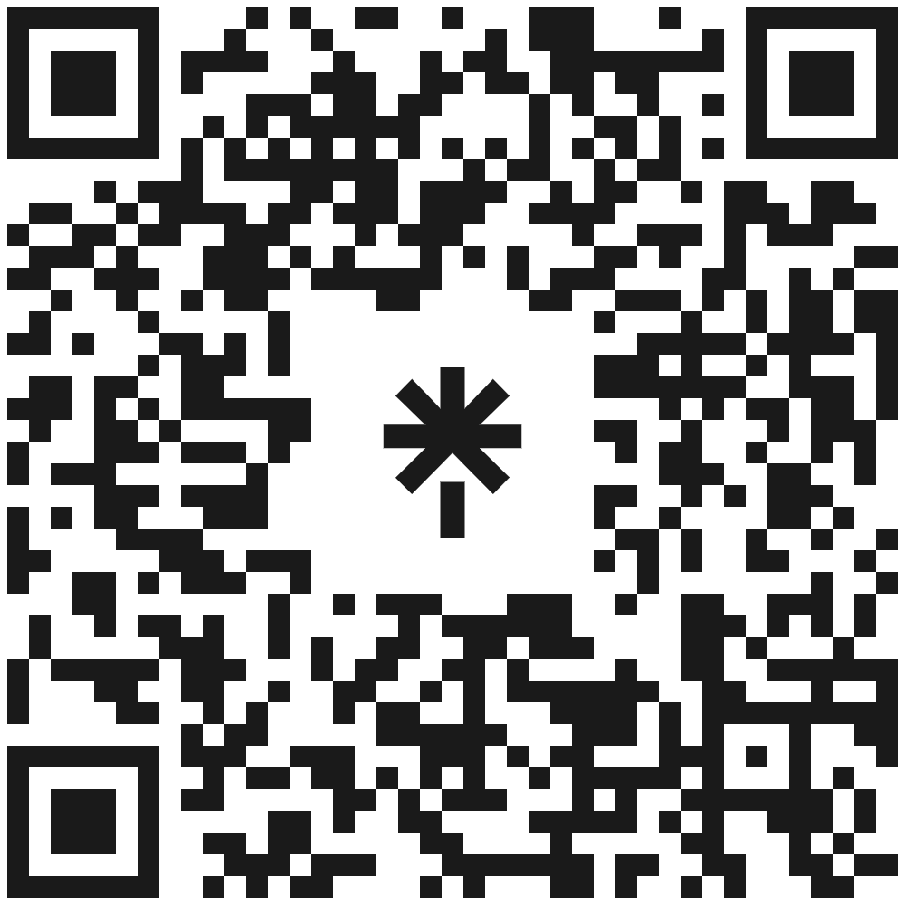







Let’s stay in touch
www.eScienceCenter.nl
info@esciencecenter.nl
+31 (0)20 460 4770
@eScienceCenter
Netherlands Escience Center
@eScienceCenter@akademienl.social

